Slide 1

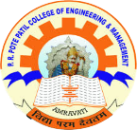
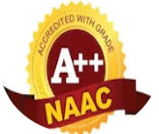
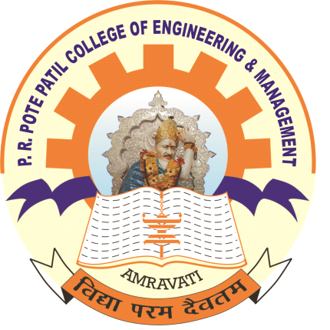
P. R. Pote (Patil) College of Engineering & Management, Amravati
(An Autonomous Institute)
Department of Artificial Intelligence and Data Science
Presentation on
FUTURE SCOPE AI
(CAREER GUIDANCE)
Presented By
Aishwary Barmase
Arjun Mankar
Puja Tiple
Khushi Patel
Guided By
Prof.Y.M.Babnekar
Year 2024-25
Notes:
qqqq

Slide 2
Abstract
This project aims to develop a user-friendly application that provides personalized self-assessment and career guidance. Leveraging AI and machine learning, the application will assess a user's skills, interests, and personality through interactive quizzes and gather relevant academic and personal information. Based on this data, the application will. 1) Identify skill gaps and areas for improvement. 2) Recommend suitable career paths aligned with the user's profile. 3) Suggest personalized learning paths with relevant courses and certifications. 4) Present insights and recommendations through visually appealing dashboards and reports.The application will be accessible via both web and mobile platforms, ensuring user-friendliness and accessibility. The project will utilize a combination of technologies including [React, Python, APIs etc.] for development and [Cloud Technology] for deployment. This project will provide valuable insights into career exploration and empower individuals to make informed decisions about their future.
AI&DS Department, PRPCEM

Slide 3
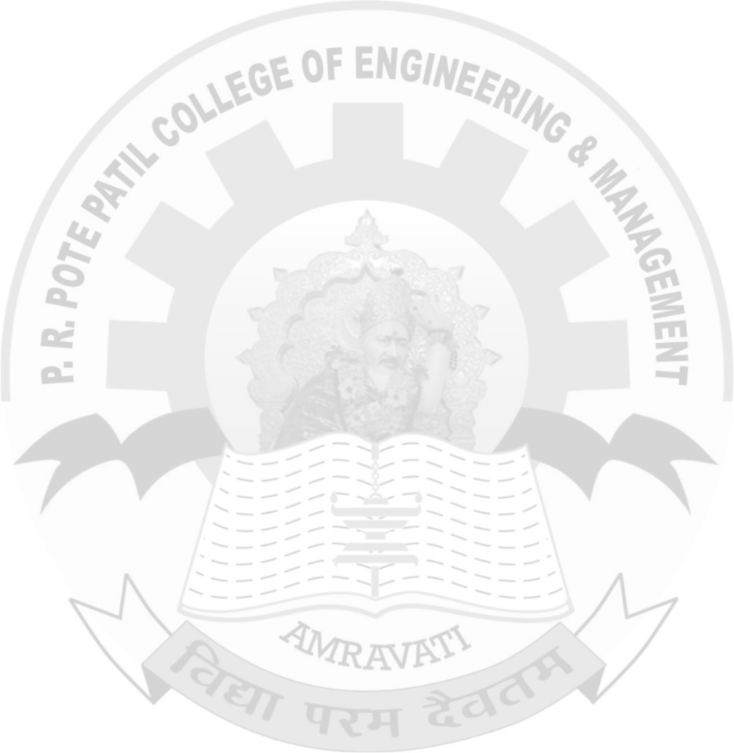
Introduction
The Career Guidance Project aims to empower individuals in making informed career choices by providing comprehensive resources, personalized assessments, and expert advice. In today's rapidly evolving job market, many individuals face challenges in identifying their strengths, interests, and potential career paths. This project addresses these challenges by offering workshops, one-on-one counseling sessions, and access to a wealth of information on various industries and professions. By fostering self-awareness and equipping participants with the tools they need to navigate their career journeys, the project seeks to enhance employability and promote lifelong learning. Ultimately, our goal is to inspire confidence and clarity in career decision-making, helping individuals achieve their professional aspirations.
AI & DS Department , PRPCEM
2

Slide 4
AIM & Objectives
Aim:
To empower individuals to make informed career choices by providing personalized assessments, resources,career guidance.
Objectives:
Self-Assessment: Facilitate self-discovery through assessments that identify strengths, interests, and values.
Career Exploration: Provide comprehensive information on various industries, job roles, and educational pathways.
Skill Development: Offer course recommendation and personalized suggestions to enhance essential skills for the job market.
Networking Opportunities: Connect participants with industry professionals and mentors for guidance and support.
Lifelong Learning: Promote continuous personal and professional development through resources and ongoing support.
AI & DS Department , PRPCEM
3

Slide 5
Problem Statement
Many individuals struggle to make informed career choices due to a lack of self-awareness, limited access to career information, and insufficient guidance on skill development. This project aims to address these challenges by providing personalized assessments, comprehensive resources, and recommendations to empower individuals in their career decision-making process.
Many individuals face difficulties in navigating their career paths due to a lack of personalized guidance, limited access to relevant information, and insufficient understanding of their own skills and interests. This project seeks to provide tailored career guidance solutions that enable users to make informed decisions, develop essential skills, and explore diverse career opportunities effectively.
AI & DS Department , PRPCEM
4

Slide 6
Literature Survey
To review existing research and scholarly work on career guidance practices, their impact, and evolving trends in the field.Career guidance is defined as a structured process that supports individuals in making informed educational and occupational choices (Watts & Sultana, 2004).It plays a significant role in improving career decision-making, reducing unemployment, and aligning talent with industry needs.A combination of self-assessment tools, counseling, and experiential learning leads to better outcome. Gaps in awareness about non-traditional or emerging career fields.Socio-economic factors still heavily influence career decisions.
Recommendations:Strengthen career education in schools and colleges.Use data analytics for personalized guidance.Encourage collaboration between educational institutions and industry.
AI & DS Department , PRPCEM
5

Slide 7
Idea / Methodology
Objective: To develop a structured approach that helps individuals identify suitable career paths based on their interests, strengths, and market opportunities.
Methodology Steps:
Initial Assessment:
Conduct surveys or psychometric tests to understand interests, aptitudes, and personality traits.
Gather data on current knowledge and awareness about various career options.
Information Sharing:
Provide detailed insights into industries, emerging job roles, and required skills.
Share real-life success stories, job market trends, and educational pathways.
One-on-One Counseling:
Personalized sessions with career counselors to discuss individual goals.
Address doubts, career confusion, and help set achievable objectives.
Skill Mapping & Gap Analysis:
Match individual profiles with career requirements.
Identify skill gaps and recommend relevant training, courses, or certifications.
Goal Setting & Planning:
Help students create a step-by-step career action plan.
Include short-term and long-term goals, along with milestones.
All diagrams of proposed system
AI & DS Department , PRPCEM
6

Slide 8
Screen shots/ Results
AI & DS Department , PRPCEM
8

Slide 9
Result Analysis
AI & DS Department , PRPCEM
9

Slide 10
Opportunities and Challenges
Opportunities :
Career Assessments: Offer personality and skills assessments to help individuals identify suitable career paths.
Skill Development Programs: Create training sessions focused on in-demand skills relevant to local job markets.
Challenges :
Diverse Needs of Participants: Participants may come from various educational backgrounds, career stages, and industries, making it challenging to provide tailored guidance that meets everyone's needs. Balancing the content to be relevant and useful for a diverse audience can be difficult.
Limited Resources and Funding: Career guidance projects often face constraints in terms of budget and resources. This can limit the ability to host workshops, bring in expert speakers, or provide one-on-one mentoring, ultimately affecting the quality and reach of the program.
AI & DS Department , PRPCEM
10

Slide 11
Conclusion
In conclusion, effective career guidance plays a crucial role in helping individuals navigate their professional paths and make informed decisions about their futures. By integrating various theories and practices, such as personality assessments, skills evaluations, and market research, career guidance can empower individuals to identify their strengths, interests, and opportunities. Moreover, the increasing importance of adaptability in today’s dynamic job market highlights the need for continuous career development and lifelong learning. Ultimately, a well-structured career guidance program not only supports personal growth but also enhances overall job satisfaction and success, contributing to a more fulfilled and productive workforce.
AI & DS Department , PRPCEM
12

Slide 12
References
4. Udemy • Hosts a wide range of courses on career guidance, job search strategies, and personal branding.
• Link: https://www.udemy.com/courses/search/?q=career%20development
7. Khan Academy • Provides free resources and courses on various subjects, including career exploration and skills development.
• Link: Khan Academy Careers
AI & DS Department , PRPCEM
13

